Slide 1
The Bill of Rights
Chapter 4 Notes

Slide 2
Big Ideas
The First Amendment protects five basic freedoms that are essential to the American way of life.
The first 10 amendments to the Constitution describe the rights of American citizens.
Some Americans have not always enjoyed the full rights of United States citizens.
In the 1950s and 1960s, many African Americans began an organized fight for their rights as citizens.

Slide 3
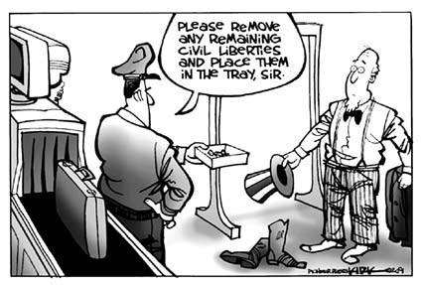
Civil liberties
Our Civil Liberties are the freedoms we have to think and act without government interference or fear of unfair treatment.
They ensure that we can develop our own beliefs and express ourselves freely.
These are protected by the first 10 Amendments.

Slide 4
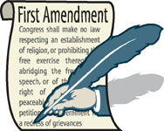
First amendment freedoms
Freedom of Religion
Freedom of Speech
Freedom of the Press
Freedom of Assembly
Freedom to Petition
These are the freedoms protected by our First Amendment.

Slide 5
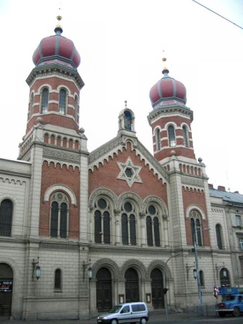
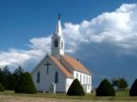
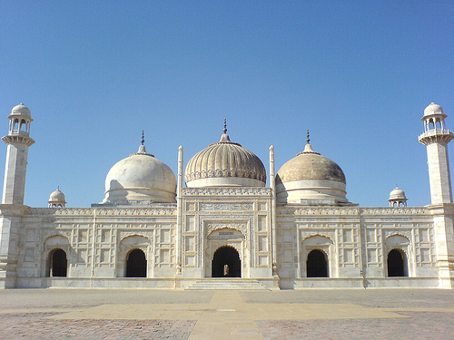
Freedom of Religion
You are free to practice your own religious beliefs as long as they don’t break federal or state laws.
Government should not show favoritism to one religion over another.
“Separation of Church and State” in NOT in the Constitution…it came from a letter written by Jefferson!

Slide 6
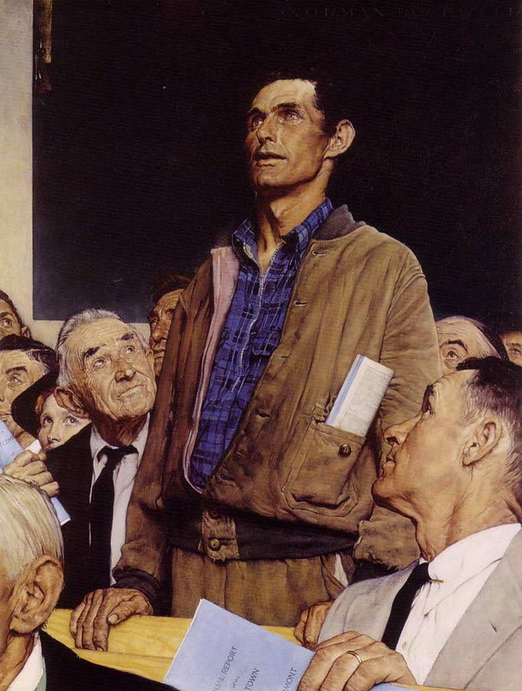
Freedom of Speech
You are free to speak your mind or opinion.
You can openly question and ridicule the government without fear of persecution.
Speech can be spoken words, written words, or sometimes other actions or items put on display.
There have been some limits to free speech when safety comes into question.

Slide 7
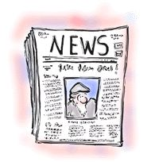
Freedom of the press
The news media is free to report on the news they receive without fear of persecution by the government.
The government is not allowed to tell newspapers or television what they may and may not say in their news reports.
There are some limits on this such as nudity, graphic violence, or certain language during certain times of day in order to protect the “innocent”.

Slide 8
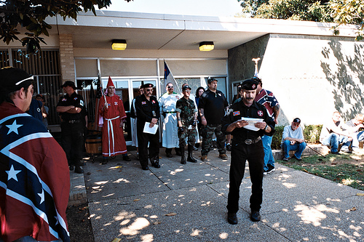
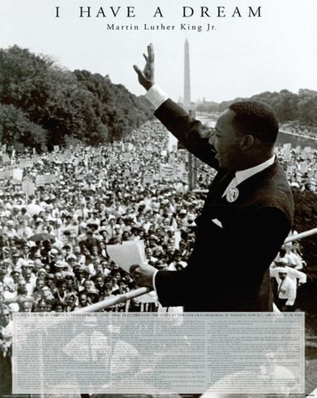
Freedom of assembly
The people are free to assemble in groups to show support for a position they hold or to protest the government or other organization.
The assemblies must remain peaceful and in many cases require a permit if they’re using public spaces.

Slide 9
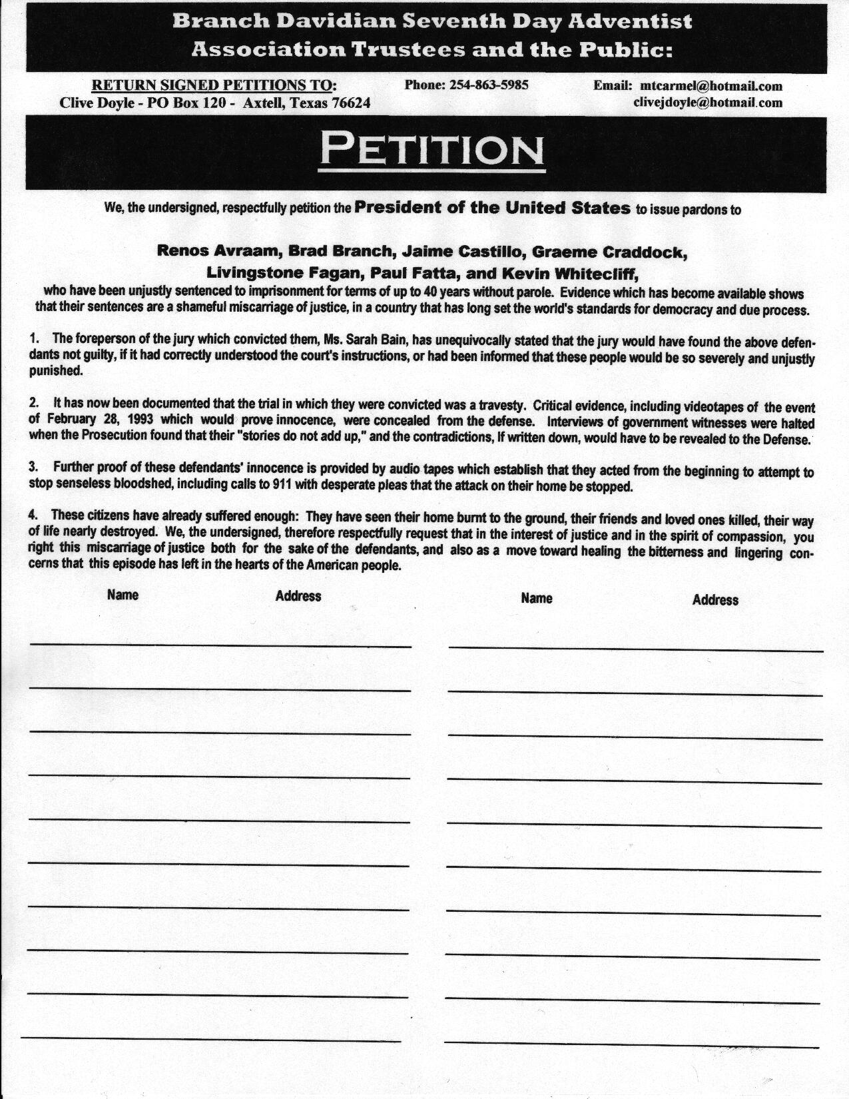
Freedom to petition
The people have the right to complain to the government.
They can contact a congressmen directly and individually or they can ban together and collect signatures on a petition.
A petition is a written statement followed by the signatures of the people that support it.

Slide 10
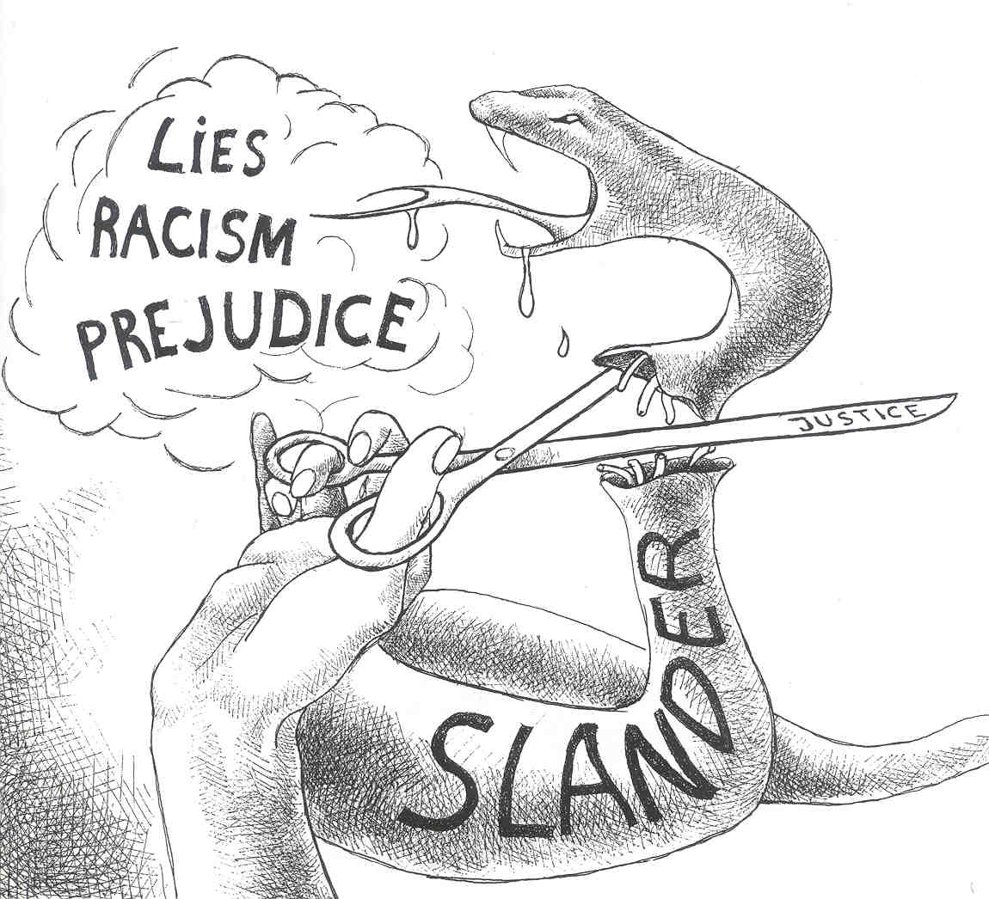
First amendment limits
While the first amendment protects your freedom of speech it does not mean that people can say anything they want to.
Things such as lies, racism, and prejudice are considered slander or hurtful personal attacks that are sometimes limited by government.

Slide 11
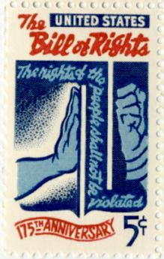
Bill of rights
The first 10 Amendments are called the Bill of Rights.
They were added to the Constitution in 1789 to ensure that the government would have limits on interfering with the rights of the people.
They were demanded by the Anti-Federalists.

Slide 12
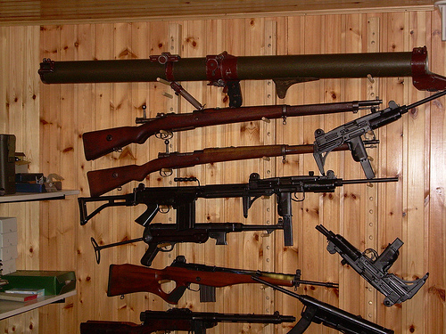
Second amendment (Guns)
The second amendment guarantees citizens the right to own firearms.
This amendment had nothing to do with hunting for food.
The founders just fought a war with an unfair government.
They believed that citizens should own firearms to keep the government in check.
Thomas Jefferson believed that for democracy to work in America there would need to be a revolution every generation or two.

Slide 13
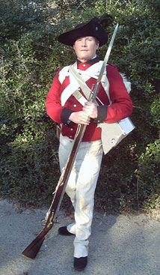
The third amendment
One of the causes of the Revolution was that the colonists didn’t like it that they were forced to house and feed British soldiers.
This was known as the Quartering Act.
This amendment says that American citizens will never have to do this unless we are at war.

Slide 14
Protecting the rights of the accused
The Bill of Rights contains several amendments that exist to prevent people from being punished for crimes they did not commit.
They generally assure that people are “innocent until proven guilty.”

Slide 15
Fourth amendment
The 4th Amendment protects us against “unreasonable searches and seizures.”
The police cannot search you or your home without probable cause. (a good reason)
They must first ask a judge for a search warrant.
They must persuade the judge that there is good reason for the search warrant.

Slide 16
The Fifth amendment
This prevents the accused from being put on trial for a serious federal crime without an indictment or formal charge by a grand jury or group of citizens that review the evidence.
It also protects against double jeopardy meaning a person cannot be put on trial for the same crime a second time if they were found innocent the first time.
It also protects your right to remain silent when being questioned.
It ensures “Due Process” meaning that the steps of the law must be followed in order.
Finally it limits the government’s power of eminent domain, or their ability to take personal property (usually land) for public use.

Slide 17
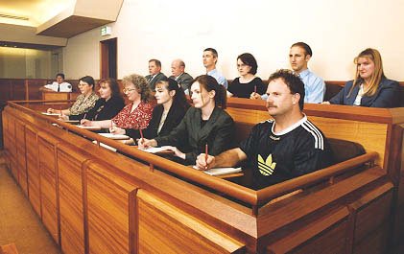
The sixth amendment
Requires that the charged be told the exact nature of the charges against them.
Offers a trial by jury, or group of citizens.
Ensures that that the trial is speedy and public.
Trials usually take place close to where the crime was committed.

Slide 18
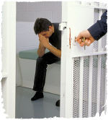
The eighth amendment
During the time between the accused being charged and put on trial they may be granted bail.
Bail is sum of money used as a security deposit to make sure the accused shows up for trial.
The more serious the crime or dangerous the person, the higher the bail may be set.
The 8th Amendment states that bail should not be excessive.

Slide 19
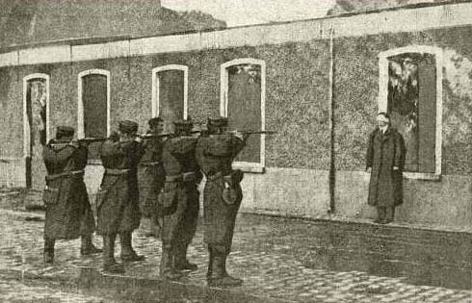
The eighth amendment
The 8th Amendment also forbids “cruel and unusual punishment.”
This is a debatable issue and there are many different opinions on what counts as cruel.
It is generally agreed that the punishment should be proportioned or balanced with the crime.

Slide 20
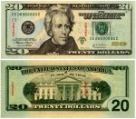
The seventh amendment
While the 5th, 6th, and 8th amendments deal with criminal cases, the 7th deals with civil cases.
Civil cases deal with disagreements between people rather than crimes.
They may be over property or business contracts.

Slide 21
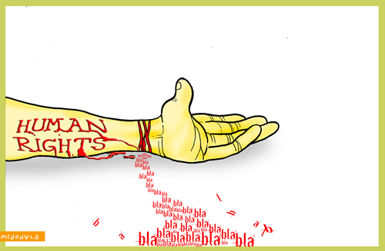
The ninth amendment
This is one of the most important amendments.
Is states that all other rights not spelled out in the Constitution are “retained by the people.”
This keeps the government from saying that the people have ONLY the rights listed in the Bill of Rights.

Slide 22
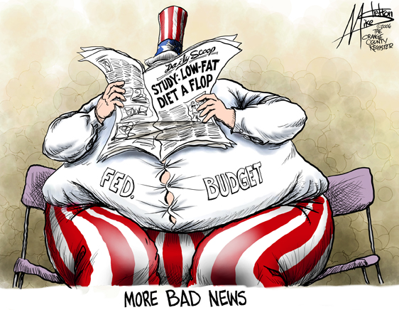
The tenth amendment
The 10th Amendment is possibly the one most often broken by the Federal Government!
It states that any power not specifically given to the Federal Government in the Constitution is reserved for the individual State Governments to deal with on an individual basis.
It’s intent was to keep the Fed from getting too strong.

Slide 23
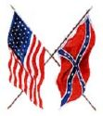
The Civil war amendments
13th: Officially outlawed slavery and forced labor in the United States.
14th: Defined a US citizen as anyone born or naturalized in the US. Forced each state to grant its citizens “equal protection of the laws.”
15th: Says that no state may take away a person’s voting rights on the basis or race. It’s aim was to guarantee suffrage or the right to vote to African Americans. It protected men as women were not allowed to vote.

Slide 24
Jim Crow Laws
Series of laws that were imposed on African Americans after the end of the civil war.
From the late 1870s-1960s
Gained power as white democrats gradually gained power back in the southern states
Number of lawful and unlawful acts that disenfranchised African Americans and poor whites
Many southern states changed their constitutions to line up with “Jim Crow” laws
Voting: Poll Tax, Literacy Test, Grandfather Claus, Residency Checks
Those who could not vote could not serve on juries or run for office
President Wilson appointed many segregationist to public office

Slide 25
Early attempts to break jim crow
Civil Rights Act of 1875- stipulated a guarantee that everyone, regardless of race, color, or previous condition of servitude, was entitled to the same treatment in public accommodations, such as inns, public transportation, theaters, and other places of recreation. This Act had little impact. An 1883 Supreme Court decision ruled that the act was unconstitutional in some respects
Plessy v. Ferguson 1896- Plessy bought a first-class ticket from New Orleans on the East Louisiana Railway. Once he had boarded the train, he informed the train conductor of his racial lineage and took a seat in the whites-only car. He was directed to leave that car and sit instead in the "coloreds only" car. Plessy refused and was immediately arrested
Executive order 9981- Desegregated the army at the end of WWII
Brown v. Board of Education- Overturned Plessy v. Ferguson

Slide 26
Major players in the Civil Rights Movement
People
Groups
Martin Luther King Jr.- Did not believe in separatism; Believed in non-violence (marches, sit-ins, speeches)
Malcolm X- Believed in separatism; violence if needed
Rosa Parks- Member of the Montgomery bus boycott
Thurgood Marshall- he presented more than 30 civil rights cases before the Supreme Court. He won 29 of them. His most important case was Brown v. Board of Education
Little Rock 9
NAACP
Regional Council of Negro Leadership
Freedom Riders

Slide 27
Major events
Birmingham campaign (1963-1964)
Montgomery bus boycott (1955-1956)
Did not want to desegregate the University of Alabama
Used a variety of nonviolent methods of confrontation, including sit-ins, kneel-ins at local churches, and a march to the county building to mark the beginning of a drive to register voters
Governor tried to stop the desegregation of the school
John F. Kennedy had to send in the national guard to desegregate the school
MLK was arrested during this campaign
December 1, 1955, Rosa Parks (the "mother of the Civil Rights Movement") refused to give up her seat on a public bus to make room for a white passenger
She refused and was arrested
Boycotted the bus company until segregation was over in Montogomery

Slide 28
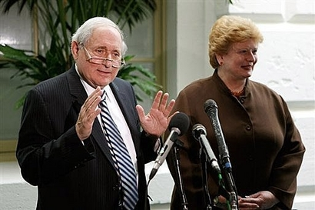
The seventeenth amendment
According to the Constitution, the people would elect their representative to the House, but the State Legislatures would elect the Senators.
This changed it so that the American people directly elected their Senators, giving them a greater voice in government.
Michigan Senators:
Carl Levin & Debbie Stabenow

Slide 29
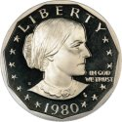
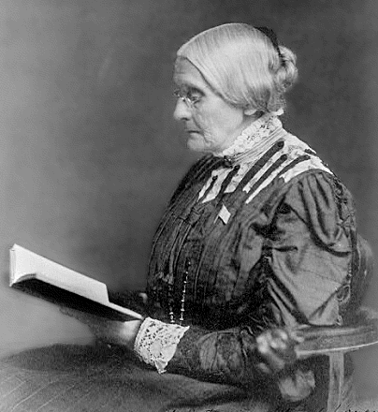
The nineteenth amendment
For many years, women were not allowed to vote in national elections.
Some states and territories, starting with Wyoming in 1869 began to allow women to vote.
The 19th Amendment assured the suffrage to all women.

Slide 30
Suffragist v. anti-suffragist
suffragist
Anti-suffragist
Men and women are equal
Should have the right to vote
Should have the right to have a job
Men and women have separate spheres
Most women don’t want to vote
Women’s role is in local affairs
Women are already represented by their husbands
It is dangerous to change a system that works
Women do not fight for their country

Slide 31
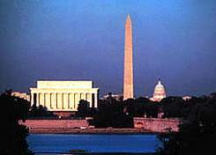
The twenty-third amendment
Because Washington, D.C. is not a state, it’s residents were not allowed to vote for many years.
This gave them the right to vote in presidential elections.
They still don’t have equal representation in congress!

Slide 32
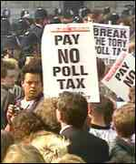
The twenty-fourth amendment
In order to keep African Americans and the poor from voting in elections, several states had poll taxes. This was a tax that had to be paid in order to vote.
The 24th made poll taxes illegal in first federal, then all elections.

Slide 33
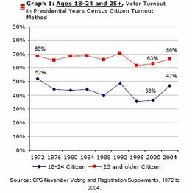
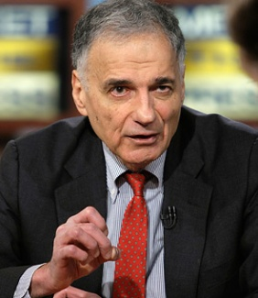
The twenty-sixth amendment
For many years, most states set a legal voting age at 21 years old.
During the Vietnam War, when many of the soldiers fighting were 18 -20 years old, this amendment was passed setting the age to vote in national elections at 18.
Ralph Nader thinks it should be 16!

